Slide 1
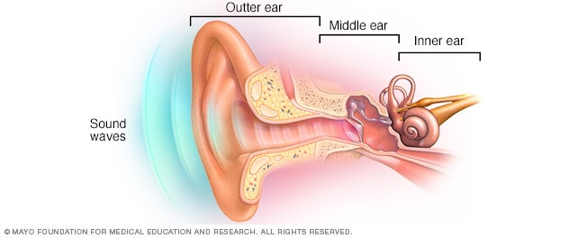
Daily Review
CFU 1
Which area of the ear is responsible for amplifying sound waves?
The human ear is divided into 3 areas:
Outer ear – where sound waves are collected.
Middle ear – where the sound waves are amplified.
Inner ear – where sound is changed into electrical signals and sent to the brain.
CFU 2
What is the function of the inner ear?
Vocabulary
Amplify: the process of making a sound wave louder.

Slide 2
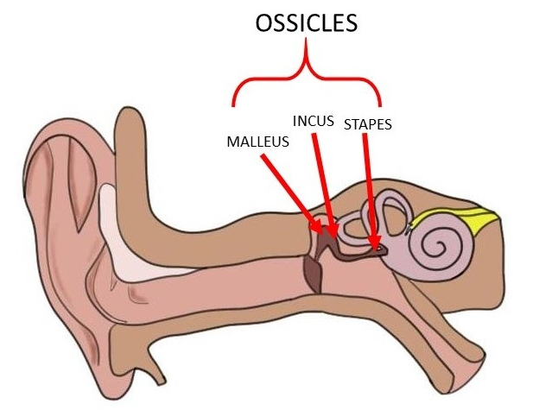
Daily Review
CFU 1
What is the function of the ossicles?
Middle ear – where sound waves are amplified
The middle ear contains three small bones called the ossicles.
They are the:
Malleus (hammer)
Incus (anvil)
Stapes (stirrup)
They vibrate in response to vibrations from the eardrum, and transmit sound to the oval window.
The oval window is a thin membrane connecting the middle ear and inner ear.
CFU 2
Describe the path that sound takes to travels from the pinna to the oval window.
Oval window
Eardrum
Eustachian Tube

Slide 3
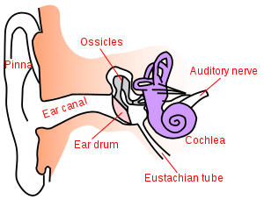
Daily Review
CFU 1
Name the part of the inner ear that is responsible for balance, not hearing.
Inner ear – where sound is changed into electrical signals and sent to the brain
Cochlea
Snail shaped bone, filled with fluid and tiny hairs.
Vibrations create waves in the fluid that move the hairs.
These hairs contain receptor cells which pass nerve impulses to the auditory nerve
Auditory Nerve
Carries all of the information about the sound signal to the brain for interpretation.
CFU 2
Which part of the cochlea receives information about a sound?
CFU 2
True or False: The auditory nerve interprets the sound.
Semicircular canals

Slide 4
Problems with Hearing Year 9 Physics

Slide 5
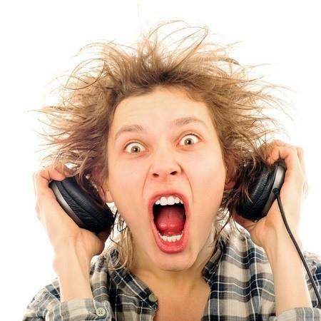
Learning Objectives
CFU
What will we be learning today?
Describe sound level and the scale used to measure it.
Identify a hearing impairment and methods of treatment.
Activate Prior Knowledge
Think, Pair, Share: If you put your ear buds in and accidentally have the volume turned up high, what happens?
Why might this happen?

Slide 6
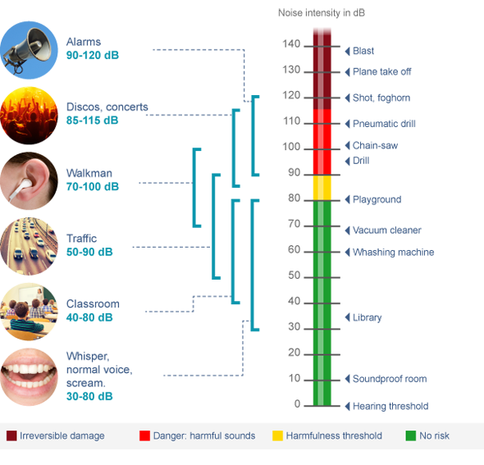
Concept Development
Sound level
A measure of the intensity of sound that we hear.
Measured in decibels (dB)
Named after Alexander Graham Bell, the inventor of the telephone.
As the sound level increases by 10, it gets 10 times more intense.
CFU 1
If the sound level increases from 30 dB to 40 dB, what is the increase in intensity?
CFU 2
If the sound level increases from 30 dB to 50 dB, what is the increase in intensity?

Slide 7
Skill Development/Guided Practice
CFU 1
At what sound level are we at risk of causing damage to our ears?
Use the decibel scale diagram to help you answer each question.
CFU 2
What types of noises are capable of causing permanent hearing damage? What sound level are these?
CFU 3
Construction workers work with drills all day, suggest a way that they reduce their risk of hearing damage.

Slide 8
Relevance
Understanding the types of sounds that are safe, or dangerous, will help you to protect your hearing. You only get one pair of ears, so look after them!
Understanding the types of noises that can cause hearing damage, will help you to understand ways of preventing and treating hearing loss.

Slide 9
Skill Closure
What unit of measurement do we use for sound level? By how much does sound intensity increase for each step on the scale?
Skill Closure
Above what sound level should we use hearing protection?
Skill Closure
Describe a type of sound capable of causing hearing loss?

Slide 10
Independent Practice
Complete the Problems with Hearing worksheet on a paper copy or on your device using pages 76 -77 of the textbook.

